Slide 1













CONSUMER GOODS INSIGHTS
ATLIQ HARDWARES

Slide 2
objectives
AtliqHardware, a fictional company, stands out as a leading computer hardware manufacturer in India, boasting a robust presence in various other countries.
However, the management has acknowledged a lack of comprehensive insights, hindering their ability to make timely, informed, and strategic decisions based on data.
There is a proposal to augment the data analytics team by bringing onboard junior data analysts.
To evaluate potential candidates, Tony Sharma, the Director of Data Analytics, intends to organize an SQL challenge aimed at assessing both technical expertise and soft skills.
The company is looking to gain insights for ten ad hoc requests.
ATLIQ HARDWARES

Slide 3
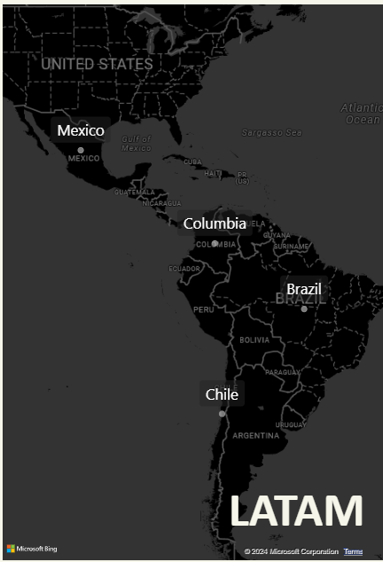

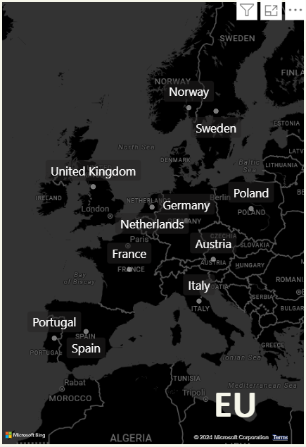
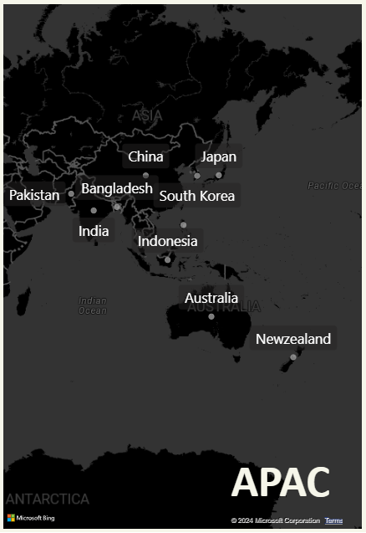
Company’s market
ATLIQ HARDWARES

Slide 4


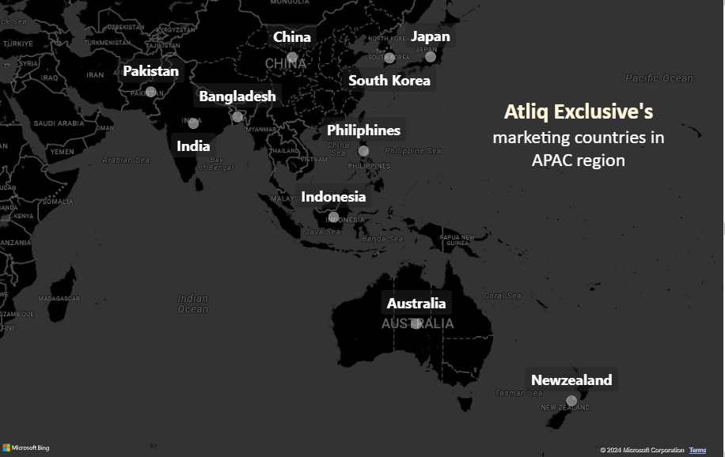
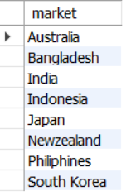





CONSUMER GOODS INSIGHTS
Markets in APAC Region
Q
1
2
3
4
5
6
7
8
9
10
Provide the list of markets in which customer "Atliq Exclusive" operates its business in the APAC region.
ATLIQ HARDWARES

Slide 5
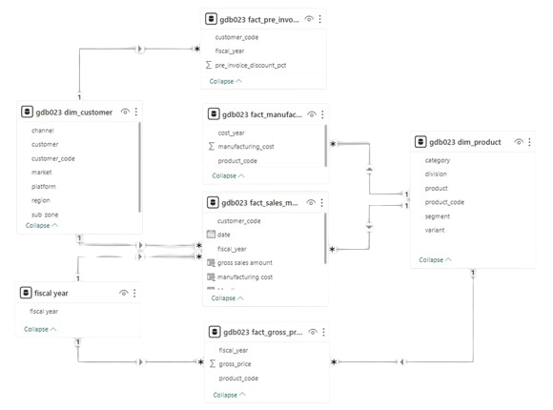


REQUESTS, Tools, AND DATA

Slide 6
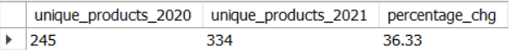
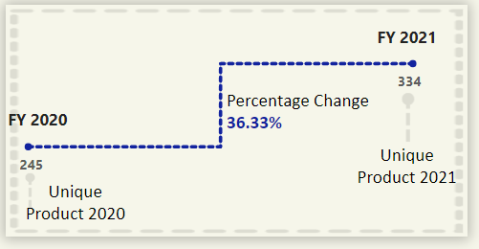
1
2
3
4
5
6
7
8
9
10
% change of unique products
Q
What is the percentage of unique product increase in 2021 vs. 2020? The final output contains these fields, unique_products_2020 unique_products_2021 percentage_chg

Slide 7
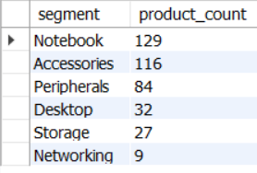

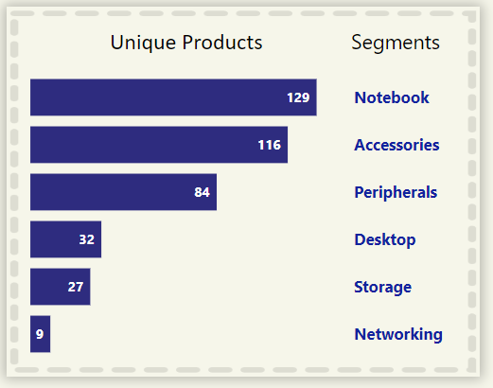
1
2
3
4
5
6
7
8
9
10
Q
Unique product in each Segment
Provide a report with all the unique product counts for each segment and sort them in descending order of product counts. The final output contains 2 fields
segment
product_count
Insights
The manufacturing growth for segments such as notebooks, accessories, and peripherals is notably higher when compared to desktops, storage, and networking products.
Notebooks, accessories, and peripherals together account for 83% of the total manufactured products.

Slide 8
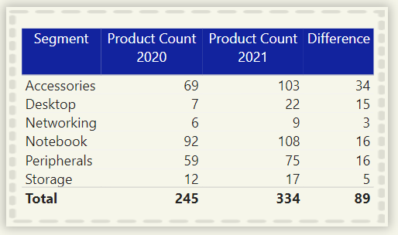
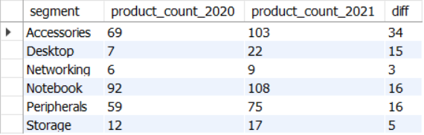

1
2
3
4
5
6
7
8
9
10
Q
Increase in unique product count
Follow-up: Which segment had the most increase in unique products in 2021 vs 2020? The final output contains these fields
segment
product_count_2020
product_count_2021
difference
Insights
Accessories experienced the most substantial increase in production.
storage and networking segments are seeing slower production growth compared to other segments.

Slide 9
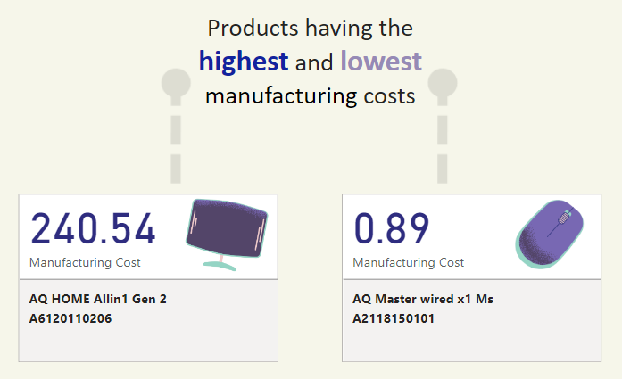
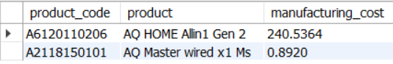
1
2
3
4
5
6
7
8
9
10
Q
Product with Manufacturing Cost
Get the products that have the highest and lowest manufacturing costs. The final output should contain these fields
product_code,
product
manufacturing_cost
Insights
AQ Master wired x1 Ms mouse (Variant: Standard1) has the lowest manufacturing cost among the products analyzed.
AQ Home Allin1 Gen2 personal desktop (Variant: Plus3) has the highest manufacturing cost.

Slide 10
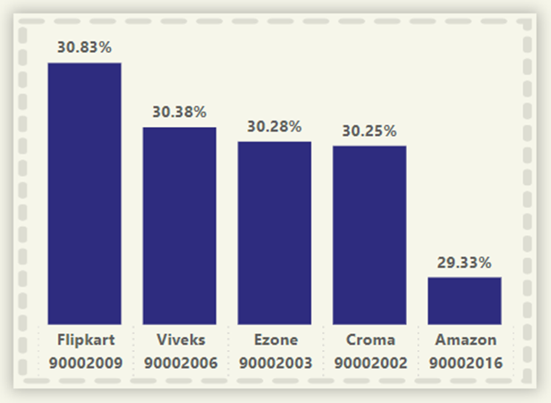
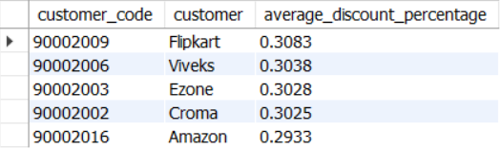
1
2
3
4
5
6
7
8
9
10
Q
Top customers by Pre_invoice_discount
Generate a report which contains the top 5 customers who received an average high pre_invoice_discount_pct for the fiscal year 2021 and in the Indian market. The final output contains these fields, customer_code customer average_discount_percentage
Insights
Flipkart received the highest average pre-invoice discount.
Amazon received the lowest average pre-invoice discount.

Slide 11
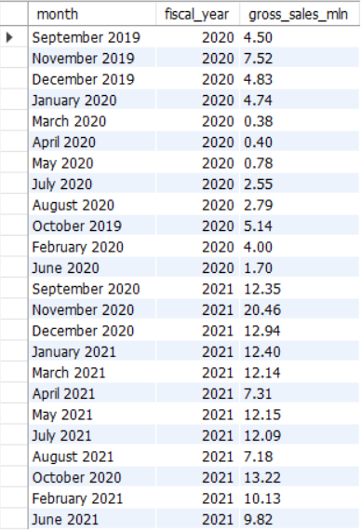
1
2
3
4
5
6
7
8
9
10
Q
Gross Sales Report
Get the complete report of the Gross sales amount for the customer “Atliq Exclusive” for each month. This analysis helps to get an idea of low and high-performing months and take strategic decisions. The final report contains these columns:
Month
Year
Gross sales Amount
Insights
March 2020 recorded the lowest gross sales total for both fiscal years.
November 2020 saw the highest gross sales total for both fiscal years.
73.8% of the total gross sales figure is attributed to FY2021..

Slide 12
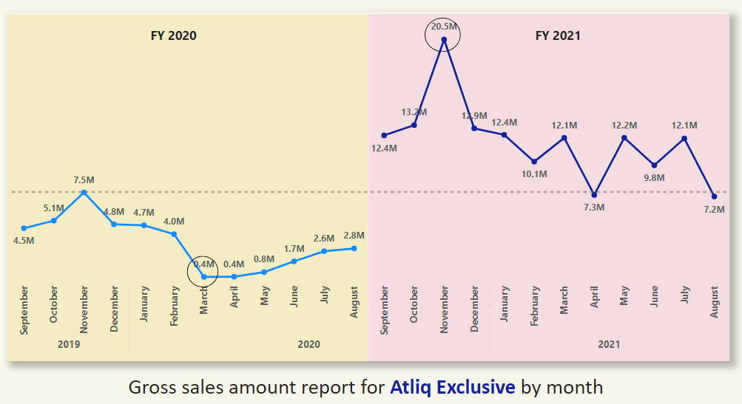
1
2
3
4
5
6
7
8
9
10
Q
Gross Sales Report

Slide 13
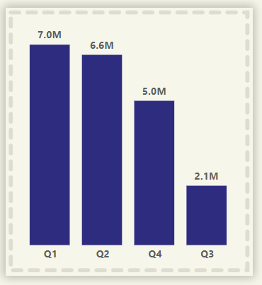
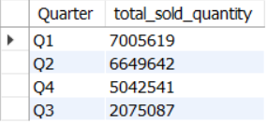
1
2
3
4
5
6
7
8
9
10
Q
Sold Quantity by quarter
In which quarter of 2020, got the maximum total_sold_quantity? The final output contains these fields sorted by the total_sold_quantity, Quarter total_sold_quantity
Insights
The most units were sold in Quarter 1 of FY2020.
Quarter 3 had the least number of units sold.
December had the highest overall quantity of units sold.
March had the lowest overall quantity of units sold.
Quarter 1 accounted for around 34% of the total units sold for FY2020.

Slide 14
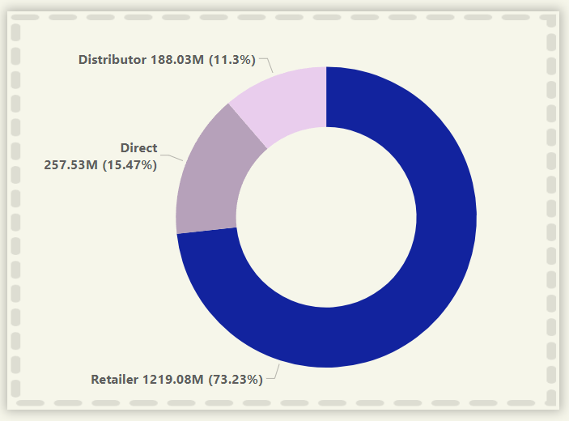
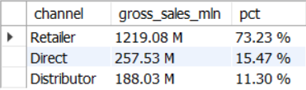
1
2
3
4
5
6
7
8
9
10
Q
Gross Sales by Channels
Which channel helped to bring more gross sales in the fiscal year 2021 and the percentage of contribution? The final output contains these fields, channel gross_sales_mln percentage
Insights
Channel: "Retailer " helped bring maximum sales to the company with 73.23% as the contribution percentage.
Channel: "Distributor " makes the least contribution at a percentage of11.3%

Slide 15
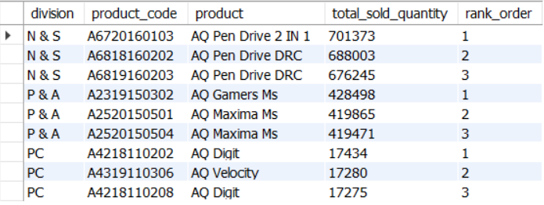
1
2
3
4
5
6
7
8
9
10
Q
Division by total_sold_quantity
Get the Top 3 products in each division that have a high total_sold_quantity in the fiscal_year 2021? The final output contains these fields:
Division, product_code, product, total_sold_quantity, rank_order

Slide 16
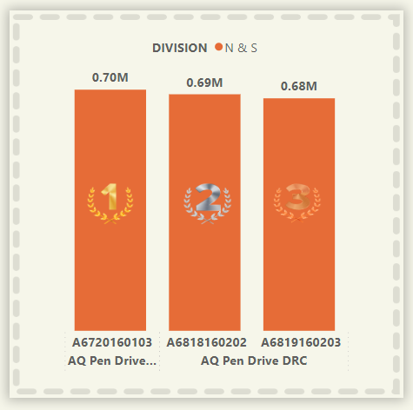
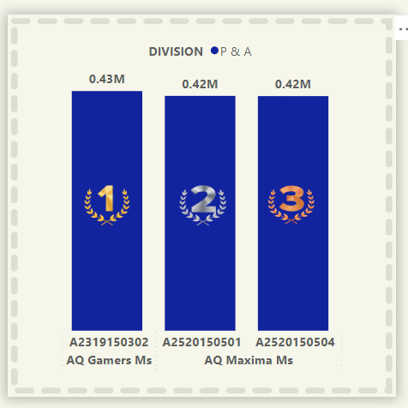
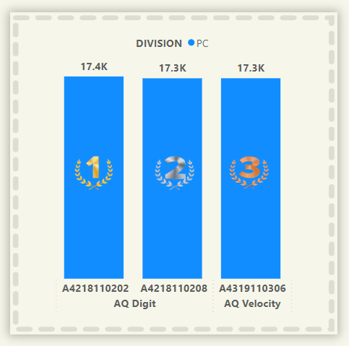
Division by total_sold_quantity

Slide 17
Thanks !
Any Doubts or Questions ?
Feel free to ask…..

